Slide 1
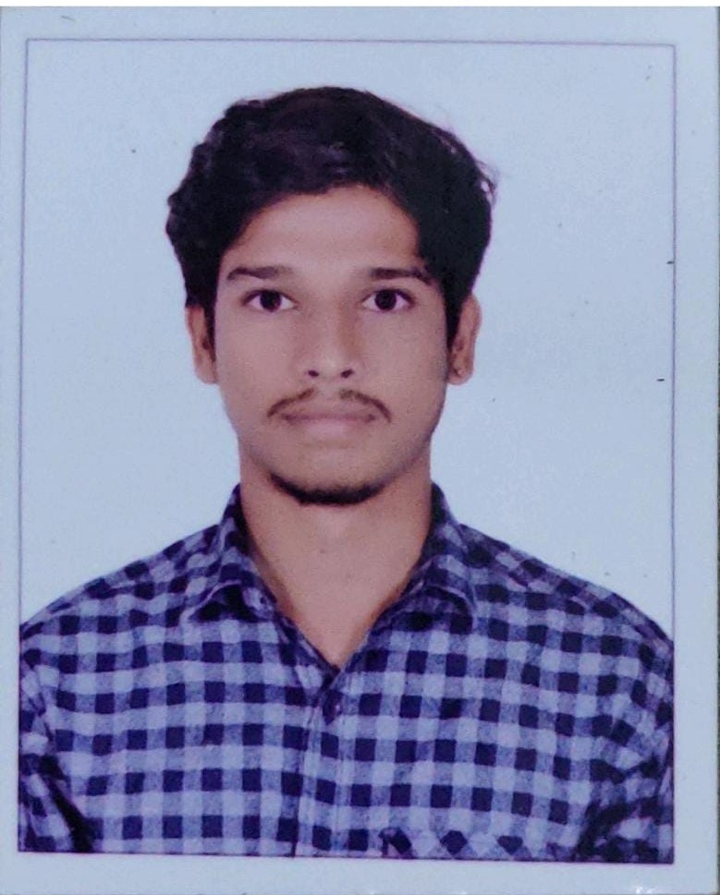
Chandrashekar Jetty
Education and certificates
Bachelor of Technology Computer Science: 2016 - 2020
Analyst/Software Engineer
Base Location: Hyderabad
_{Email ID:} chandra-shekar.jetty@capgemini.com
Skills
Spring Boot
Core Java Bootstrap
Mobile No: GRADE:A4
+91 8125620243
Backend Spring Boot Rest-API
Strengths
Capable of mastering new technologies.
Project
Electricity Bill Payment Application
It aims to pay electricity bill through online and helps us to save the valuable time. Without login in any website you can pay and know your last electricity bill via Electricity bill payment app.
FLIGHT BOOKING SYSTEM
Working knowledge on Angular and Java Microservice Development using Spring framework on an intermediate level.
Database
MySQL
PostgreSQL MongoDB-NO SQL
Willing to take any challenging positions and
contribute the best to the industry.
Web Technologies
HTML CSS
TypeScript JavaScript
Flight booking system aims to develop a web application which aims at providing flight details, flight availability, as well as facility to book tickets for customers.
Tools
Backend: Core Java, Spring Boot, JPA, Hibernate, PostgreSQL
Frontend: HTML, CSS, Bootstrap, Angular JS
AddOne GitHub Postman

Slide 2
Presentation Title | Author | Date © Capgemini 2017. All rights reserved | 1

